Slide 1
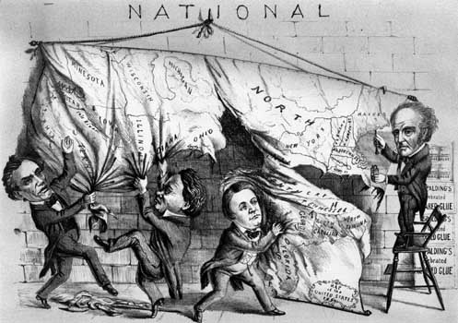
The Election of 1860:
The Election
that Divided a Nation

Slide 2
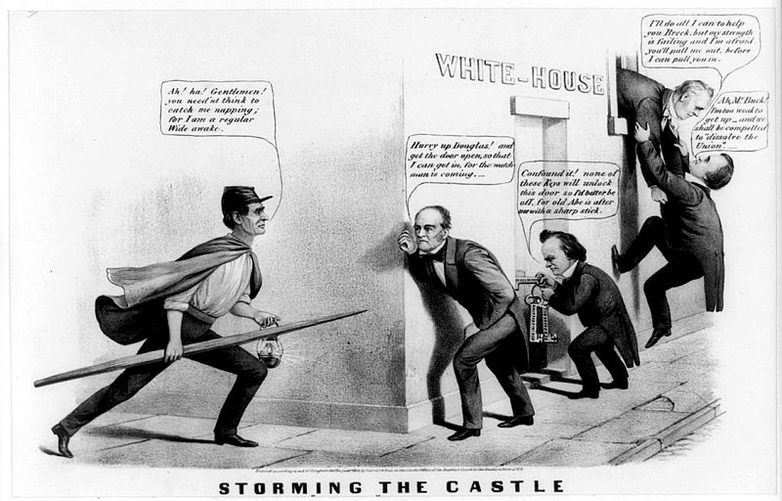
James Buchanan Will Not Seek a 2nd Term so who will be The next President

Slide 3
The
Candidates

Slide 4
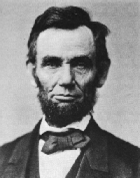
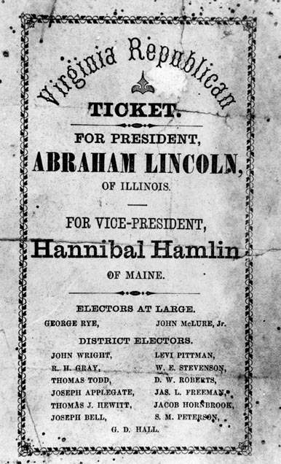
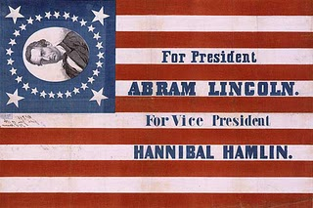
The Republican Party
&
Abraham Lincoln

Slide 5
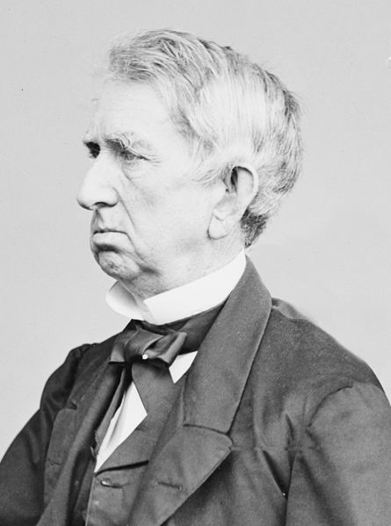
The Republican Party
Republican Party eagerly awaited Presidential Election despite hostilities between the North and the South
Lincoln’s Rival was Senator William Seward of New York and the favorite for the nomination

Slide 6
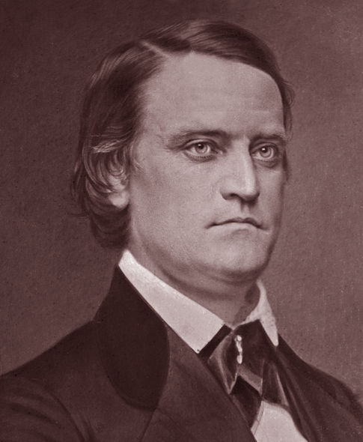
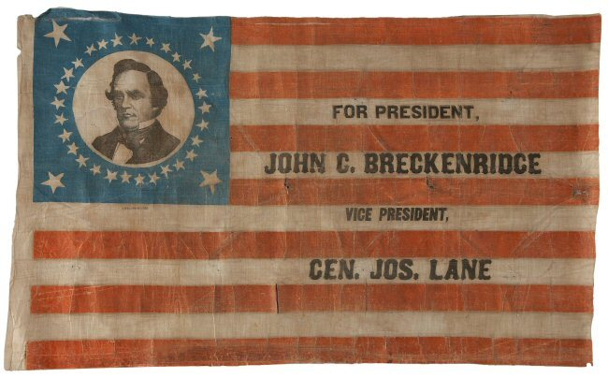
The Southern Democratic Party
&
John Breckinridge
“ A Division in the Democratic Party”

Slide 7
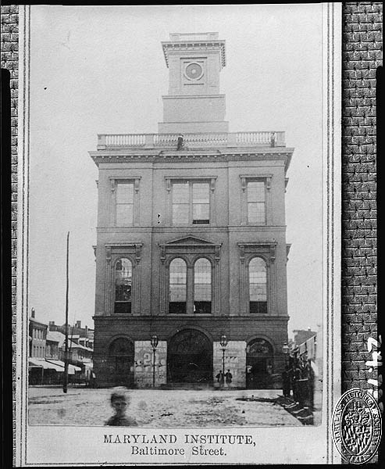
The Democratic Party
The party was divided on the candidate to nominate
The party splits and helps to give the victory to another party
The South nominates Breckinridge and the North nominates Douglas

Slide 8
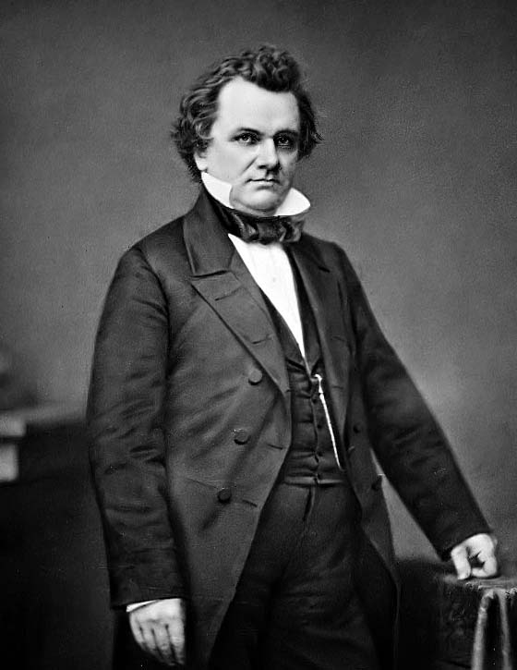
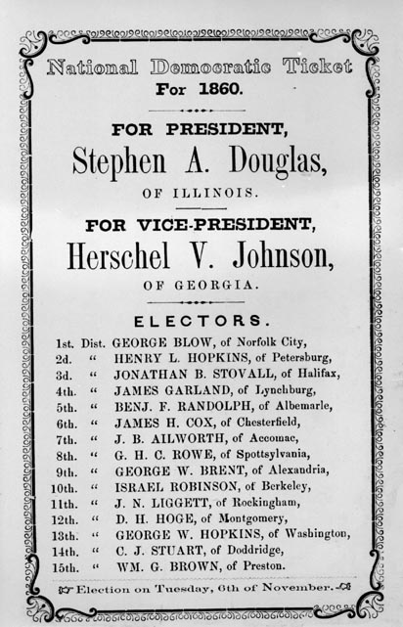
The Northern Democratic Party:
Senator Stephen Douglas
Could he win a divided Democratic Party and Unite the Nation ???

Slide 9
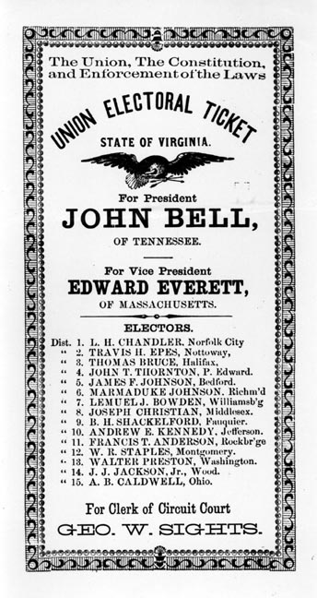
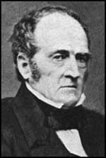
The Constitutional Union:
John Bell
Receives a 592,906 votes in the election for president

Slide 10
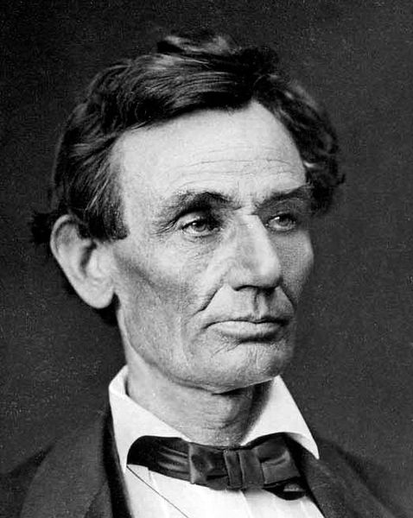
The Rise of Abraham Lincoln
Illinois
No Republican has been elected President
Not the Favorite to win the nomination
His unknown name helped him defeat Seward
Moderate in views
Pledged to halt the spread of slavery
Was not listed on the ballots in all the states (The South)

Slide 11


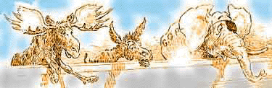
The
Results

Slide 12
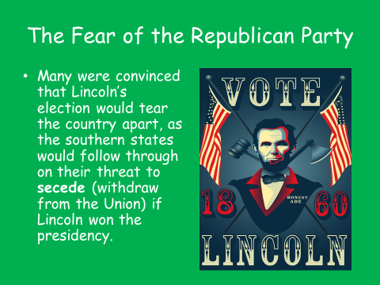

Slide 13
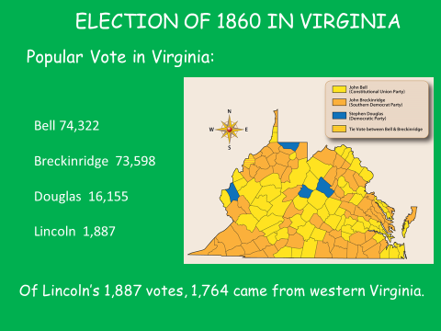
Source: Clairmont Press (West Virginia: 150 Years of Statehood)

Slide 14
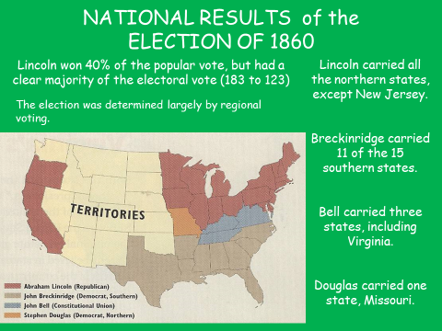
Source: Clairmont Press (West Virginia: 150 Years of Statehood)

